Slide 1
Database Design
This chapter deals with the goal of evaluating relational schemas for design quality.

Slide 2
Database Design
The 2 levels at which we measure “"goodness" of relation schemas
Logical (or conceptual) level : how users interpret the relation schemas and the meaning of their attributes.
Implementation (or storage) level : how the tuples in a base relation are stored and updated
Database design methodologies
A bottom-up design methodology (Design by synthesis.)
A top-down design methodology (Design by analysis)

Slide 3
Topics to be discussed
Informal Design guidelines for Relational Schemas
Functional Dependencies
Normal Forms based on Primary Keys
Definitions of 2nd and 3rd Normal Forms
Boyce – Codd Normal forms
Properties of Relational Decompositions
Algorithms for Relational Database
Schema Design

Slide 4
Four Informal Design Guidelines for Relational Schemas

Slide 5
Four Informal Design Guidelines for Relation Schemas are :
Semantics of the attributes
Reducing the redundant values in tuples
Reducing the null values in tuples
Disallowing the possibility of generating spurious tuples

Slide 6
Semantics of the attributes
When we form a relation schema, the attributes belonging to that relation should have certain real-world meaning and a proper interpretation.
If the conceptual design is done carefully followed by a systematic mapping into relations , the resulting design should have a clear meaning.
In general, the easier it is to explain the semantics of the relation, the better the relation schema design will be.

Slide 7
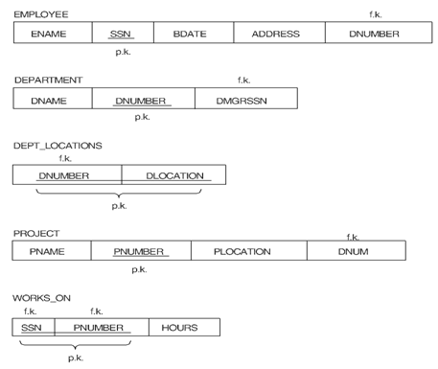
Semantics of the attributes
To illustrate this, consider , a simplified version of the COMPANY relational database schema
All the relation schemas here may be considered as easy to explain and hence good from the standpoint of having clear semantics.

Slide 8
Semantics of the attributes
We can thus formulate the following informal design guideline.
GUIDELINE 1:
Design a relation schema so that it is easy to explain its meaning. Do not combine attributes from multiple entity types and relationship types into a single relation.

Slide 9

Semantics of the attributes
An Example poor relational schema designs
Combining EMPLOYEE and DEPARTMENT into EMP_DEPT
Grouping attributes from EMPLOYEE, PROJECT and WORK_ON into EMP_PROJ
So the violation of guideline 1

Slide 10
Redundant Information in Tuples and Update Anomalies
One goal of schema design is to minimize the storage space that the base relations (files) occupy.
Grouping attributes into relation schemas has a significant effect on storage space.
Let us compare the space used by the two base relations EMPLOYEE and DEPARTMENT with that for an EMP_DEPT base relation in the following database states

Slide 11
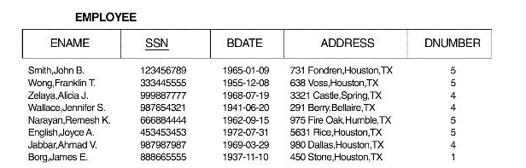
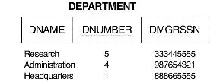
Redundant Information in Tuples and Update Anomalies
A Database state for EMPLOYEE
A Database state for DEPARTMENT

Slide 12
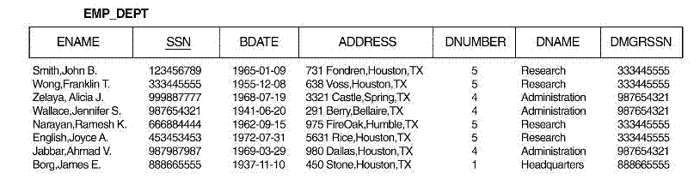
Redundant Information in Tuples and Update Anomalies
The same Database state for EMP_DEPT
In EMP_DEPT, the attribute values pertaining to a particular department (DNUMBER, DNAME, DMGRSSN) are repeated for every employee who works for that department.
In the EMPLOYEE relation only the department number (DNUMBER) is repeated for each employee who works in that department.

Slide 13
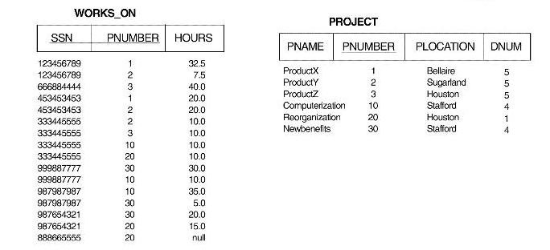
Redundant Information in Tuples and Update Anomalies
A Database state for WORKS_ON and PROJECT

Slide 14
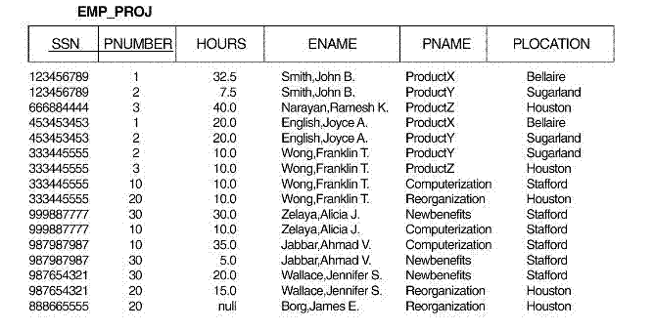
Redundant Information in Tuples and Update Anomalies
The same Database state for EMP_PROJ
Similar comments apply to the EMP_PRO] relation which augments the WORKS_ON relation with additional attributes from EMPLOYEE and PRO]ECT.

Slide 15
Redundant Information in Tuples and Update Anomalies
Another serious problem with EMP_DEPT and EMP_PROJ is update anomalies
These can be classified into
insertion anomalies →2 types
consistency problem
null values problem
deletion anomalies
modification anomalies

Slide 16
Redundant Information in Tuples and Update Anomalies
insertion anomalies : consistency problem
Example : To insert a new tuple for an employee who works in department number 5, we must enter the attribute values of department 5 correctly so that they are consistent with values for department 5 in other tuples in EMP_DEPT.

Slide 17
Redundant Information in Tuples and Update Anomalies
insertion anomalies : consistency problem
In the design of the Figure 14.1 , we do not have to worry about this consistency problem because we enter only the department number in the employee tuple;

Slide 18
Redundant Information in Tuples and Update Anomalies
insertion anomalies : null values problem
It is difficult to insert a new department that has no employees as yet in the EMP_DEPT relation. The only way to do this is to place null values in the attributes for employee. This causes a problem because SSN is the primary key of EMP_DEPT

Slide 19
Redundant Information in Tuples and Update Anomalies
insertion anomalies : null values problem
This problem does not occur in the design of Figure 14.1, because a department is entered in the DEPARTMENT relation whether or not any employees work for it, and whenever an employee is assigned to that department, a corresponding tuple is inserted in EMPLOYEE.

Slide 20
Redundant Information in Tuples and Update Anomalies
deletion anomalies
If we delete from EMP_DEPT an employee tuple that happens to represent the last employee working for a particular department, the information concerning that department is lost from the database. This problem does not occur in the database of Figure 14.1 because DEPARTMENT tuples are stored separately.

Slide 21
Redundant Information in Tuples and Update Anomalies
modification anomalies
In EMP_DEPT, if we change the value of one of the attributes of a particular department-say, the manager of department 5 -we must update the tuples of all employees who work in that department; otherwise, the database will become inconsistent.

Slide 22
Redundant Information in Tuples and Update Anomalies
Based on the preceding three anomalies, we can state the guideline that follows
GUIDELINE 2:
Design the base relation schemas so that no insertion, deletion, or modification anomalies are present in the relations. If any anomalies are present, note them clearly and make sure that the programs that update the database will operate correctly..

Slide 23
Null Values in Tuples
When we group many attributes, if many of the attributes do not apply to all tuples in the relation, then we end up with many nulls in those tuples.
Nulls can have many problems:
Wastage space at the storage level
Problems with understanding the meaning of the attributes
Problems with specifying JOIN operations at the logical level.
Problems with aggregate operations such as COUNT or SUM

Slide 24
Null Values in Tuples
Guideline3 :
As far as possible, avoid placing attributes in a base relation whose values may frequently be null. If nulls are unavoidable, make sure that they apply in exceptional cases only and do not apply to a majority of tuples in the relation

Slide 25

4. Generation of Spurious Tuples
Consider EMP_PROJ relation of Figure 14.1b and its relation state

Slide 26
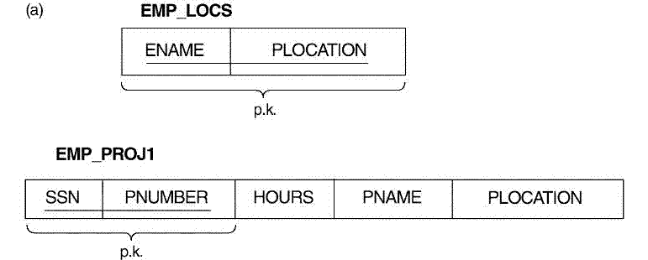
4. Generation of Spurious Tuples
Let us split EMP_PROJ into 2 relation EMP_PROJ1 and EMP_LOCS as shown below.
A tuple in EMP_LOCS means that the employee whose name is ENAME works on some project whose location is PLOCATION
A tuple in EMP_PROJ1 means that the employee whose social security number is SSN works HOURS per week on the project whose name, number, and location are PNAME, PNUMBER, and PLOCATION

Slide 27
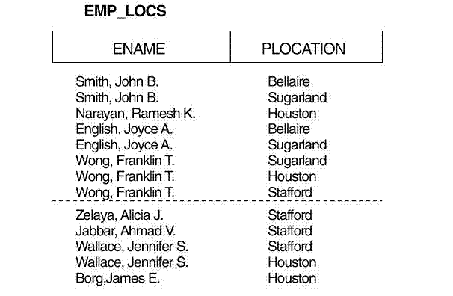
4. Generation of Spurious Tuples
Now produce tuples for EMP_LOCS by applying project operation to EMP_PROJ relation state , So we get tuples as shown below
Tuples for EMP_LOCS obtained by applying Project operation to EMP_PROJ

Slide 28
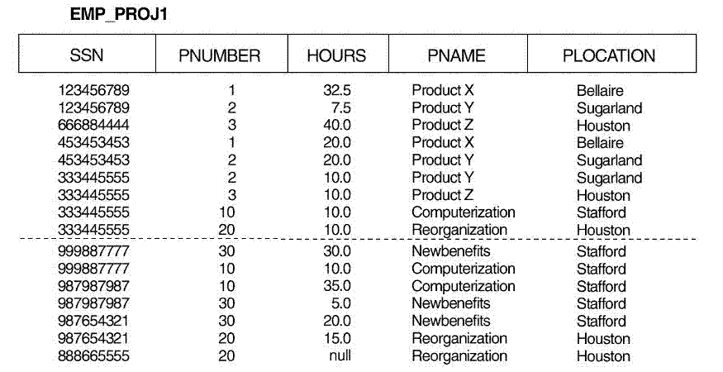
4. Generation of Spurious Tuples
Now produce tuples for EMP_PROJ1 by applying project operation to EMP_PROJ relation state , So we get tuples as shown below
Tuples for EMP_PROJ1 obtained by applying Project operation to EMP_PROJ

Slide 29
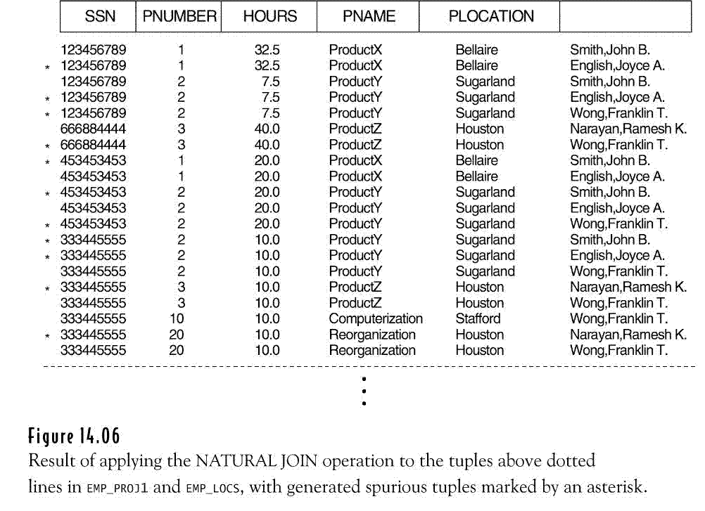
4. Generation of Spurious Tuples
Generation of Spurious Tuples
Now apply natural join operation (*) on EMP_PROJ1 and EMP_LOCS to get the original relation EMP_PROJ. We consider only the tuples above dotted lines. So we get following relation
EMP_PROJ1 * EMP_LOCS

Slide 30
4. Generation of Spurious Tuples
Please note the following
Additional tuples that were not in EMP_PROJ are called spurious tuples because they represent spurious or wrong information that is not valid. The spurious tuples are marked by asterisks (*).
Decomposing EMP_PROJ into EMP_LOCS and EMP_PROJ! is undesirable because, when we JOIN them back using NATURAL JOIN, we do not get the correct original information. This is because PLOCATION is neither a primary key nor a foreign key in either EMP_LOCS or EMP_PROJ1

Slide 31
4. Generation of Spurious Tuples
GUIDELINE 4.
Design relation schemas so that they can be joined with equality conditions on attributes that are either primary keys or foreign keys in a way that guarantees that no spurious tuples are generated.
Avoid relations that contain matching attributes that are not (foreign key, primary key) combinations, because joining on such attributes may produce spurious tuples.

Slide 32
Summary of Design Guidelines
Semantics should be unambiguous and well defined .
Anomalies that imply additional work to be done during insertion into and modification of a relation, and that may cause accidental loss of information during a deletion from a relation.
Waste of storage space due to nulls and difficulty of performing aggregation operations and joins due to null values.
Generation of invalid and spurious data during joins on improperly related base relations

Slide 33
Functional Dependencies
A functional dependency is a constraint between two sets of attributes from the database

Slide 34
FORMAL DEFINITION
Let R be a Universal relation schema. R = {A1,A2…An}
Let X and Y be two sets of attributes of R
Let r be a relation state of R.
A functional dependency between X and Y, denoted by X → Y, specifies a constraint that for any two tuples t1 and t2 in r of R that have t1[X] =t2[X], we must also have t1[Y] = t2[Y].

Slide 35
FORMAL DEFINITION
Note the following:
X→Y means that the values of the Y component of a tuple in r depend on, or are determined by, the values of the X component;
Or we also say that there is a functional dependency from X to Y or that Y is functionally dependent on X.
The abbreviation for functional dependency is FD or f.d.
If X is a candidate key of R (one of the primary keys of R) , then X→ Y for any subset of attributes Y of R.
If X →Y in R, this does not say whether or not Y → X in R.

Slide 36
An Example:
Consider the relation schema EMP_PROJ
From the semantics of the attributes, we know that the following functional dependencies should hold:
SSN → ENAME
PNUMBER → {PNAME, PLOCATION}
{SSN, PNUMBER} → HOURS

Slide 37
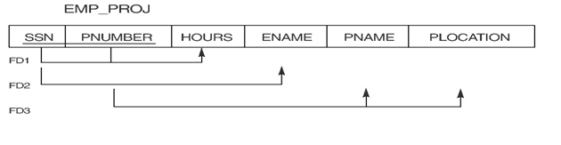
Diagrammatic notation for displaying FDs
FD1 : {SSN, PNUMBER} → HOURS
FD2 : SSN → ENAME
FD3 : PNUMBER → {PNAME, PLOCATION}

Slide 38
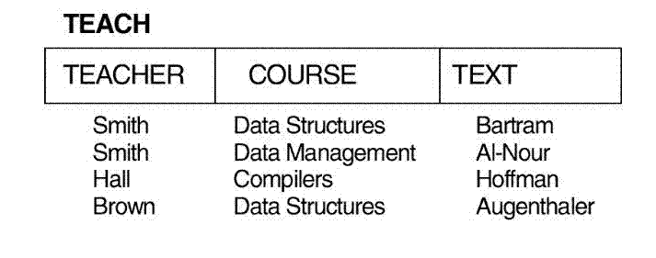
Functional Dependencies – not a property of a relation state
An FD cannot be inferred automatically from a given relation extension r but must be defined explicitly by someone who knows the semantics of the attributes of R.
For example,
TEXT → COURSE . Is it true for all legal states of TEACH?
But we can definitely say TEACHER → COURSE is not true.

Slide 39
Definition Closure of F (F⁺ )
Formally , the set of all dependencies that include F as well as all dependencies that can be inferred from F is called the closure of F; denoted by F⁺
^{Example :}
F = {SSN → {ENAME, BDATE, ADDRESS, DNUMBER},
^{DNUMBER → {DNAME,DMGRSSN}} }
Some of the additional functional dependencies that we can infer from F :
^{SSN → {DNAME, DMGRSSN}}
^{SSN → SSN}
^{DNUMBER → DNAME}
The closure F⁺ of F is the set of all functional dependencies that can be inferred from F.

Slide 40
Inference Rules for Functional Dependencies
The schema designer specifies the functional dependencies F that are semantically obvious;
However, numerous other functional dependencies hold in all legal relation states that satisfy the dependencies in F can be inferred or deduced from the FDs in F.
For Example:
DEPT_NO → MGR_SSN
MGR_SSN → MGR_PHONE
Then we can infer , DEPT_NO → MGR_PHONE from the above FDs
Here DEPT_NO → MGR_PHONE is inferred or deduced FD.

Slide 41
Inference Rules for Functional Dependencies
Standard Inference Rules are used to systematically determine infer dependencies, from a given set of dependencies.
Standard Inference Rules:
IR1 (reflexive rule): If Y subset-of X, then X → Y.
IR2 (augmentation rule): {X → Y } then XZ → YZ.
IR3 (transitive rule): {X → Y, Y →Z} then X → Z.
IR4 (decomposition, or projective rule): {X →YZ} then X → Y.
IR5 (union, or additive, rule): {X → Y, X →Z} then X → YZ.
IR6 (pseudotransitive rule): {X → Y, WY → Z } WX → Z.

Slide 42
Inference Rules for Functional Dependencies
Meaning of Inference Rules :
The reflexive rule (IR1) states that a set of attributes always determines itself or any of its subsets, which is obvious
The augmentation rule (IR2) says that adding the same set of attributes to both the left- and right-hand sides of a dependency results in another valid dependency.
According to IR3, functional dependencies are transitive
The decomposition rule (IR4) says that we can remove attributes from the right-hand side of a dependency
The union rule (IRS) allows us to do the opposite

Slide 43
Inference Rules for Functional Dependencies
Note the following :
The rules IR1 through IR3 are called Armstrong’s inference rules (sound and complete)
A functional dependency X → Y is trivial if Y subset of X ; otherwise, it is nontrivial.

Slide 44
Inference Rules for Functional Dependencies
Algorithm to Determining X⁺ ⁽the Closure of X) under F
First to determine each set of attributes X that appears as a left-hand side of some functional dependency in F
Then to determine the set of all attributes that are dependent on X.
i.e., for each set of attributes X, we determine the set X⁺ of attributes that are functionally determined by X based on F
X⁺ is called the closure of X under F

Slide 45
Inference Rules for Functional Dependencies
Algorithm : Determining X⁺, the Closure of X under F
X⁺ = X;
repeat
oldX⁺ = X⁺;
for each functional dependency Y →Z in F do
If X⁺ Y then X⁺ = X⁺ U Z;
until (X⁺ = oldX ⁺)

Slide 46
Inference Rules for Functional Dependencies
Determining X+, the Closure of X under F
Example :
F = {SSN → ENAME,
PNUMBER → {PNAME, PLOCATION},
{SSN, PNUMBER} → HOURS}
Using Algorithm we calculate the following closure sets with respect to F;
{ SSN }⁺ = { SSN, ENAME }
{ PNUMBER }⁺ = { PNUMBER, PNAME, PLOCATION }
{ SSN, PNUMBER }⁺ = { SSN, PNUMBER, HOURS, ENAME, PLOCATION, PNAME}

Slide 47
Inference Rules for Functional Dependencies
Determining X⁺, the Closure of X under F
Problem:
Calculate the closure sets with respect to F
F = { AB→C, CD→E, DE→B}
F = { A →C, AC→D, E→AD, E→H}
F = { A→BC, BC→F, B→DCE, C→DEF, E→FG}

Slide 48
Equivalence of Sets of Functional Dependencies
In this section we discuss the equivalence of two sets of functional dependencies. First, we give some preliminary definitions.
Definition: Cover of a set of functional dependencies F
A set of functional dependencies F is said to cover another set of functional dependencies E if every FD in E is also in F⁺; that is, if every dependency in E can be inferred from F; alternatively, we can say that E is covered by F.

Slide 49
Equivalence of Sets of Functional Dependencies
Definition : Equivalence of two Sets of Functional Dependencies
Two sets of functional dependencies E and F are equivalent if E⁺ ⁼ F⁺.
Hence, equivalence means that every FD in E can be inferred from F, and every FD in F can be inferred from E; that is, E is equivalent to F if both the conditions E covers F and F covers E hold.

Slide 50
Equivalence of Sets of Functional Dependencies
Steps to check equivalence of two sets F and E of functional dependencies
Calculate X⁺ with respect to F for each FD X → Y in E Check whether this X⁺ includes the attributes in Y
If this is the case for every FD in E, then F covers E
Similarly check whether E covers F
If E covers F and F covers E. then E⁺ = F⁺

Slide 51
Equivalence of Sets of Functional Dependencies
Problems :
Consider the following two sets of functional dependencies:
F = {A → C, AC → D, E → AD, E → H}
^{G = {A → CD, E → AH}.}
^{Check whether they are} ^{equivalent.}
Consider two sets of FDs, F and G,
F = {A → B, B → C, AC → D} and
G = {A → B, B → C, A → D}
Are F and G equivalent?
F = {A → B, A →C}
G = {A → B, B → C} Are F and G equivalent?

Slide 52
Minimal Sets of Functional Dependencies
A set of functional dependencies F is minimal if it satisfies the following conditions:
Every dependency in F has a single attribute for its right-hand side.
We cannot replace any dependency X → A in F with a dependency
Y→ A, where Y is a proper subset of X, and still have a set of dependencies that is equivalent to F.
We cannot remove any dependency from F and still have a set of dependencies that is equivalent to F.

Slide 53
Minimal Sets of Functional Dependencies
Condition 1 just represents every dependency in a canonical or standard form with a single attribute on the right-hand side.
Condition 2 ensures that there are no redundancies in the dependencies by having redundant attributes on the left-hand side of a dependency
Condition 3 ensures that there are no redundancies by having a dependency that can be inferred from the remaining FDs in F

Slide 54
Minimal Sets of Functional Dependencies
Definition of Minimal Cover of E
A minimal cover of a set of functional dependencies E is a minimal set of dependencies F that satisfies the property that every dependency in E is in the closure of F^{+.}
There can be several minimal covers F for a set of functional dependencies E.
We can always find at least one minimal cover F for any set of dependencies E using the following Algorithm

Slide 55
Minimal Sets of Functional Dependencies
Algorithm : Finding a Minimal Cover F for a Set of Functional Dependencies E
Set F := E.
Replace each functional dependency X → {A1,A2…An} in F by the n functional dependencies X →A1 , X →A2 , . . ., X →An .
For each functional dependency X → A in F
For each attribute B that is an element of X
if {{F - {X → A}} U {(X - {B}) → A}} is equivalent to F
then replace X → A with (X - {B}) → A in F.
For each remaining functional dependency X → A in F if (F - {X → A}) is equivalent to F, then remove X → A from F.

Slide 56
Minimal Sets of Functional Dependencies
Step 3 can be simplified as follows:
You can use the following steps to test for redundant attributes :
In an FD {X→A} from set F , to test if attribute B ϵ X is redundant do the following :
Step 1: Compute ({X} – B)⁺ using the dependencies in F
Step 2: Check that ({X} – B)⁺ contains B or A; if it does, B is redundant , (so remove it from X )

Slide 57
Minimal Sets of Functional Dependencies
Problem :
Consider the universal relation R = {A, B, C, D, E, F, G} and the set of functional dependencies F = {A→BC, BC→F, B→DCE, C→DEF, E → FG}. Find a minimal cover G for F.

Slide 58
Minimal Sets of Functional Dependencies
Problem :
Consider the universal relation R = {A, B, C, D, E, F, G, H, I,J} and the set of functional dependencies
F = {AB→C, A→ DE, B→F, F → GH, D→IJ}.
Find a minimal cover G for F

Slide 59
Minimal Sets of Functional Dependencies
Problem :
Consider the universal relation R = {A, B, C, D, E, F, G, H} and the set of functional dependencies
F = {A → B, ABCD → E, EF → G, EF → H, ACDF → EG.}
Find a minimal cover G for F

Slide 60
Minimal Sets of Functional Dependencies
Problem :
Consider the universal relation R = {A, B, C, D, E, F, G, H} and the set of functional dependencies
F = { AB -> C, C -> A, BC -> D, ACD -> B, D -> E, D -> G, BE -> C, CG -> B ,CG -> D, CE -> A, CE -> G}
Find a minimal cover G for F

Slide 61
Minimal Sets of Functional Dependencies
Problem :
Consider the universal relation R = {A, B, C, D, E, F, G} and the set of functional dependencies
G = {A→BCDE, E→FG}
find a minimal set of functional dependencies that is equivalent to G. Prove that your set is equivalent to G.

Slide 62
.
Normal Forms Based on Primary Keys

Slide 63
What is Normalization?
Normalization of data is a process of analyzing the given relation schemas based on their FDs and primary keys to achieve the following desirable properties:
minimizing redundancy
minimizing the insertion, deletion, and update anomalies
Relation schemas that do not meet the properties are decomposed into smaller relation schemas that meet desirable properties.

Slide 64
What is Normalization?
Thus, the normalization procedure provides database designers with the following:
A formal framework for analyzing relation schemas based on their keys and on the functional dependencies among their attributes
A series of normal form tests that can be carried out on individual relation schemas so that the relational database can be normalized to any desired degree.

Slide 65
What is Normalization?
The highest normal form may not guarantee a good database design. Relational schemas should also possess the following two properties:
The lossless join or nonadditive join property
→ guarantees that the no spurious tuple generation occurs after decomposition
The dependency preservation property
→ ensures that each functional dependency is represented in some individual relations resulting after decomposition

Slide 66
Normal Forms Based on Primary Keys
Definitions :
Prime Attribute :
An attribute of relation schema R is called a prime attribute if it is a member of some candidate key of R.
Non- Prime Attribute :
An attribute is called nonprime if it is not a prime attribute-that is, if it is not a member of any candidate key.

Slide 67
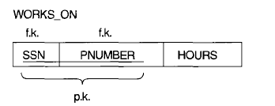
Normal Forms Based on Primary Keys
Example
Prime attributes of WORKS_ON : SSN and PNUMBER
Non Prime attributes of WORKS_ON: HOURS

Slide 68
Normal Forms Based on Primary Keys
We discuss the first three normal forms:
1NF →first normal form
2NF→ second normal form
3NF→ third normal form
These were proposed by Codd (l972) as a sequence to achieve the desirable state of 3NF

Slide 69
First Normal Form(1NF)
First normal form (INF) states that the domain of an attribute must include only atomic (simple, indivisible) values.
So 1NF is defined to disallow
multivalued attributes,
composite attributes,
their combinations.
The only attribute values permitted by 1NF are single atomic (or indivisible) values.

Slide 70
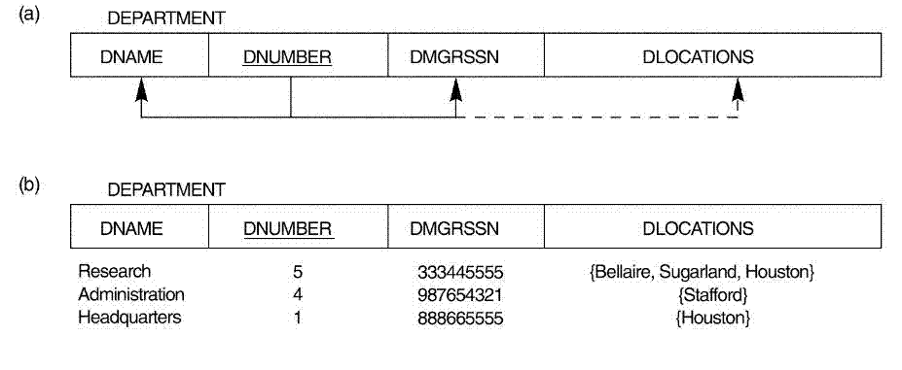
First Normal Form(1NF)
Example :
Suppose that we extend DEPARTMENT by including the DLOCATIONS attribute as shown in the fig.
As we can see , the DEPARTMENT relation is not in 1NF;

Slide 71
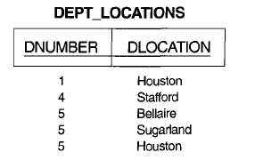
First Normal Form(1NF)
There are three main techniques to achieve first normal form for such a relation:
Remove the attribute DLOCATIONS that violates 1NF and place it in a separate relation DEPT_LOCATIONS along with the primary key DNUMBER of DEPARTMENT. The primary key of this relation is the combination {DNUMBER, DLOCATION}

Slide 72
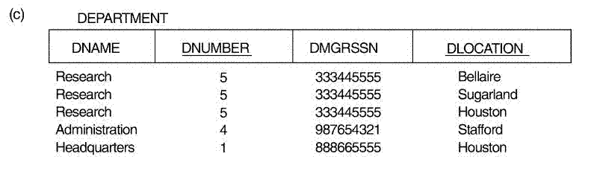
First Normal Form(1NF)
Expand the key so that there will be a separate tuple in the original DEPARTMENT relation for each location of a DEPARTMENT. In this case, the primary key becomes the combination {DNUMBER, DLOCATION}.
Disadvantage : redundancy in the relation..

Slide 73
First Normal Form(1NF)
If a maximum number of values is known for the attribute-for example, if it is known that at most three locations can exist for a department-replace the DLOCATIONS attribute by three atomic attributes: DLOCATION1, DLOCATION2, and DLOCATION3.
Disadvantage
Introducing null values if most departments have fewer than three locations.
Introducing spurious tuples
Of the three solutions above, the first is generally considered best because it does not suffer from redundancy and it is completely general

Slide 74
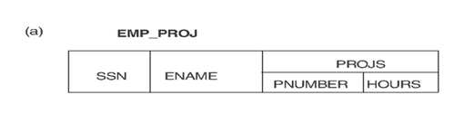
First Normal Form(1NF)
First normal form also disallows multivalued attributes that are themselves composite.
These are called nested relations because each tuple can have a relation within it..
Example :
The schema of this EMP_PROJ relation can be represented as follows: EMP_PROJ (SSN, ENAME, {PROJS(PNUMBER, HOURS)})

Slide 75
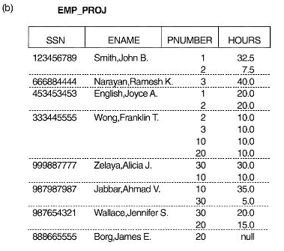
First Normal Form(1NF)
A relation state of the EMP_PROJ

Slide 76
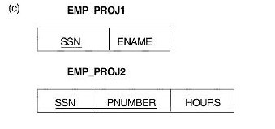
First Normal Form(1NF)
To normalize this into INF :
we remove the nested relation attributes into a new relation and propagate the primary key into it
The primary key of the new relation will combine the partial key with the primary key of the original relation.

Slide 77
Second Normal Form(2NF) :
Definitions: Full and partial functional dependency:
A functional dependency X → Y is a full functional dependency if removal of any attribute A from X means that the dependency does not hold any more;
i.e. for any attribute A ϵ X, (X - {A}) v does not functionally determine Y
A functional dependency X → Y is a partial dependency if some attribute A can be removed from X and the dependency still holds;
that is, for some A ϵ X, (X - {A}) → Y.

Slide 78
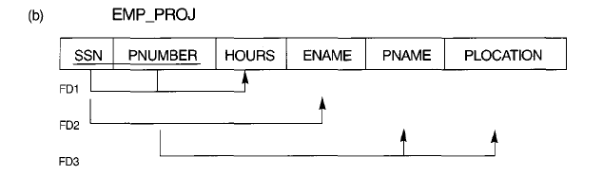
Second Normal Form(2NF) :
Full and partial functional dependency:
Example :
{SSN, PNUMBER} → HOURS is a full dependency
{SSN, PNUMBER} → ENAME is partial because SSN → ENAME holds.
Second normal form (2NF) is based on the concept of full functional dependency.

Slide 79
Second Normal Form(2NF) :
Definition. A relation schema R is in 2NF if every nonprime attribute A in R is fully functionally dependent on the primary key of R.
The EMP_PROJ relation is in INF but is not in 2NF. WHY?
→ Because of FD2 & FD3

Slide 80
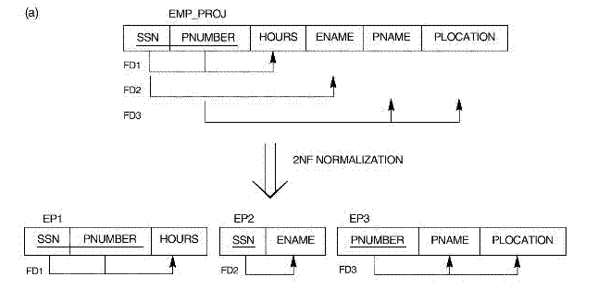
Second Normal Form(2NF) :
If a relation schema is not in 2NF, it can be "second normalized“ into a number of 2NF relations in which nonprime attributes are associated only with the part of the primary key on which they are fully functionally dependent.
FD1, FD2, and FD3 lead to the decomposition of EMP_PRO] into the three relation schemas EP1 EP2, and EP3

Slide 81
Third Normal Form :(3NF) :
Third normal form (3NF) is based on the concept of transitive dependency.
What is transitive dependency?
A functional dependency X → Y in a relation schema R is a transitive dependency if there is a set of attributes Z that is neither a candidate key nor a subset of any key of R, and both X →Z and Z → Y hold.

Slide 82
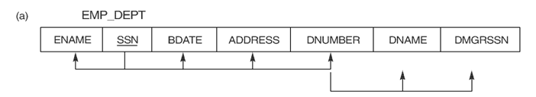
Third Normal Form :(3NF) :
Example
SSN → DMGRSSN is transitive through DNUMBER in EMP_DEPT.
Because both the dependencies SSN → DNUMBER and DNUMBER → DMGRSSN hold and DNUMBER is neither a key itself nor a subset of the key of EMP_DEPT

Slide 83
Third Normal Form :(3NF)
Definition : A relation schema R is in 3NF if it satisfies 2NF and no nonprime attribute of R is transitively dependent on the primary key.
The relation schema EMP_DEPT is in 2NF, since no partial dependencies on a key exist. However, EMP_DEPT is not in 3NF because
SSN→DNUMBER , DNUMBER→DMGRSSN, hence SSN→ DMGRSSN
SSN→DNUMBER , DNUMBER→DNAME , hence SSN→ DNAME

Slide 84
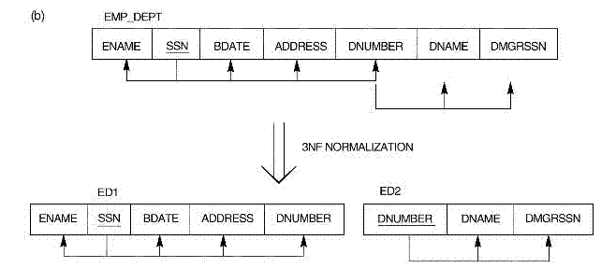
Third Normal Form :(3NF)
We can normalize EMP_DEPT by decomposing it into the two 3NF relation schemas ED1 and ED2 shown in the Figure
A NATURAL JOIN operation on ED1 and ED2 will recover the original relation EMP_DEPT without generating spurious tuples.

Slide 85
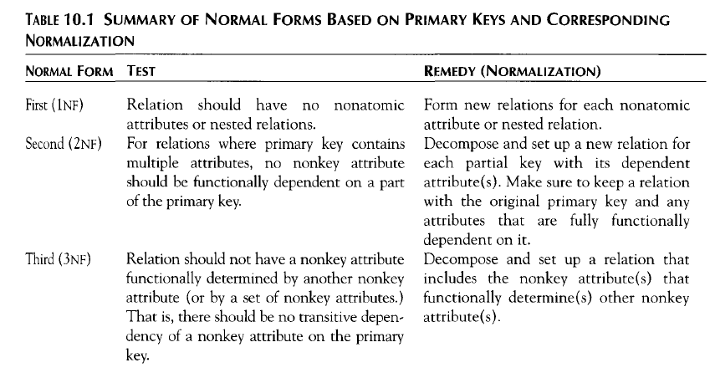
Normal Forms Based on Primary Keys

Slide 86
GENERAL DEFINITIONS OF SECOND AND
THIRD NORMAL FORMS

Slide 87
GENERAL DEFINITIONS OF SECOND AND THIRD NORMAL FORMS
The previous definition of 2NF and 3NF do not take other candidate keys of a relation, if any, into account. In this section we give the more general definitions of 2NF and 3NF that take all candidate keys of a relation into account.
Notice that this does not affect the definition of 1NF, since it is independent of keys and functional dependencies
As a general definition of prime attribute, an attribute that is part of any candidate key will be considered as prime

Slide 88
General Definition of Second Normal Form :
Definition :
A relation schema R is in second normal form (2NF) if every nonprime attribute A in R is not partially dependent on any key of R.
This definition can be restated as follows:
A relation schema R is in 2NF if every nonprime attribute A in R is fully functionally dependent on every key of R.

Slide 89
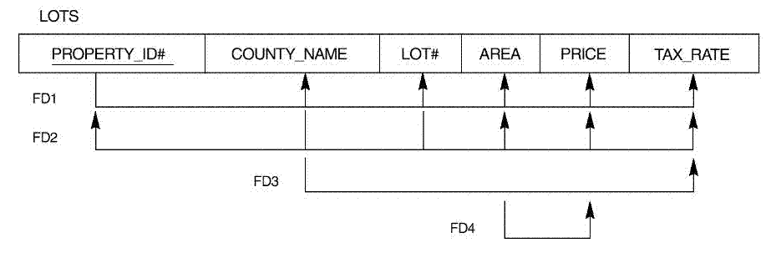
General Definition of Second Normal Form :
Example:
Consider the relation schema LOTS which describes parcels of land for sale in various counties of a state. Suppose that there are two candidate keys: PROPERTY_ID# and {COUNTY_NAME, LOT#};
This not in 2NF why?
Because of FD3

Slide 90
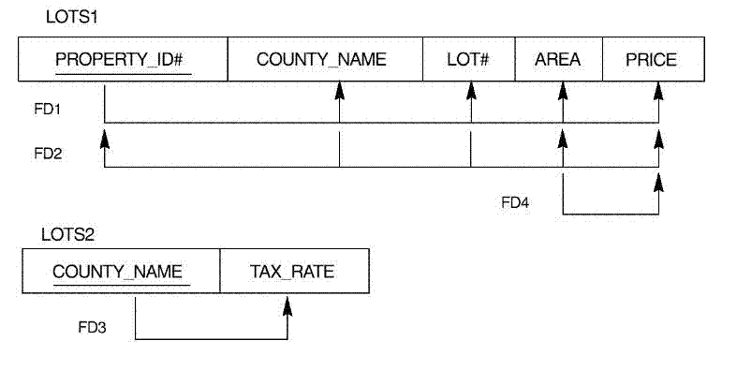
General Definition of Second Normal Form :
To normalize LOTS into 2NF, we decompose it into the two relations LOTS1 and LOTS2, shown in the following Figure

Slide 91
General Definition of Third Normal Form
Definition: A relation schema R is in third normal form (3NF) if, whenever a nontrivial functional dependency X → A holds in R, either
X is a super key of R or
A is a prime attribute of R.

Slide 92
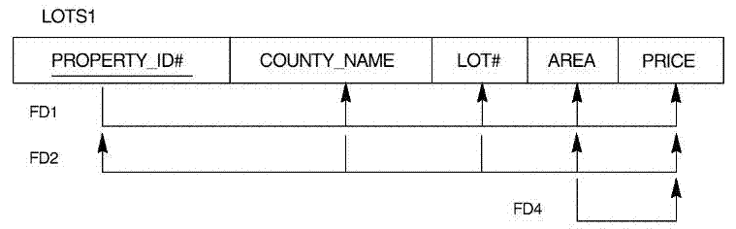
General Definition of Third Normal Form
According to this definition, LOTS2 is in 3NF.
But However, FD4 in LOTS1 violates 3NF . WHY ?
Because AREA is not a superkey OR PRICE is not a prime attribute in LOTS1.

Slide 93
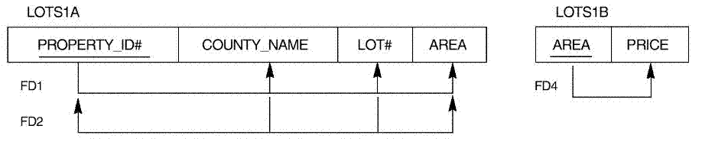
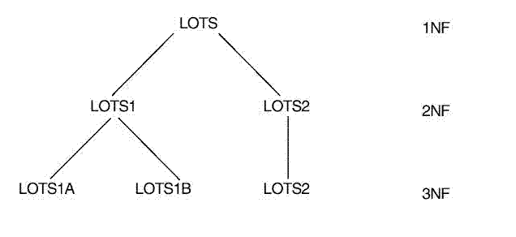
General Definition of Third Normal Form
To normalize LOTS1 into 3NF, we decompose it into the relation schemas LOTS1A and LOTS1B shown in Figure

Slide 94
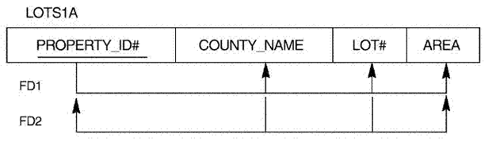
BOYCE-CODD NORMAL FORM (BCNF)
( A stronger definition for 3NF . Proposed by Boyce and Codd)
Why BCNF ?

Slide 95
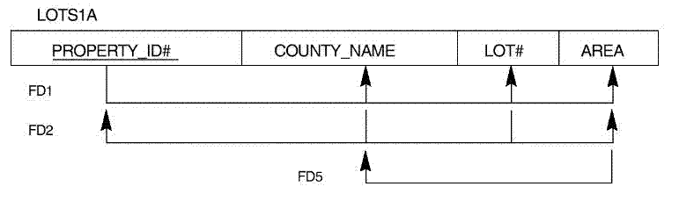
BOYCE-CODD NORMAL FORM (BCNF)
( A stronger definition for 3NF . Proposed by Boyce and Codd)
Why BCNF ?

Slide 96
BOYCE-CODD NORMAL FORM (BCNF)
( A stronger definition for 3NF . Proposed by Boyce and Codd)
Definition : A relation schema R is in BCNF if whenever a nontrivial functional dependency X→A holds in R, then X is a superkey of R.
(3NF allows A to be prime, but is absent from BCNF)

Slide 97
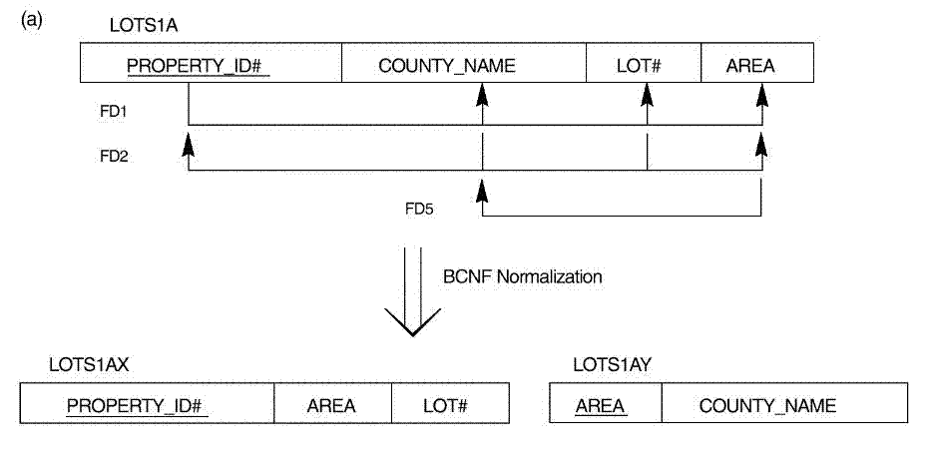
BOYCE-CODD NORMAL FORM (BCNF)
To normalize LOTS1A into BCNF , we can decompose LOTS1A into two BCNF relations LOTS1AX and LOTS 1AY, shown in the Figure
This decomposition loses the functional dependency FD2 because its attributes no longer coexist in the same relation after decomposition.

Slide 98
BOYCE-CODD NORMAL FORM (BCNF)
Consider LOTS1A relation which is in 3NF. We add additional functional dependency FD5: AREA →COUNTY_NAME
The relation schema LOTS1A still is in 3NF because COUNTY_NAME is a prime attribute. But FD5 violates BCNF in LOTS1A because AREA is not a superkey of LOTS1A.

Slide 99
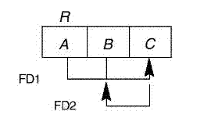
BOYCE-CODD NORMAL FORM (BCNF)
When the dependencies in a relation schema has the following pattern, the relation is in 3NF, but not in BCNF.

Slide 100
BOYCE-CODD NORMAL FORM (BCNF)
Consider another example, which shows a relation TEACH with the following dependencies:
FD1: {STUDENT, COURSE} → INSTRUCTOR
FD2: INSTRUCTOR →COURSE
Note :
{STUDENT, COURSE} is a candidate key for this relation
The dependencies shown follow the above pattern
Hence this relation is in 3NF but not in BCNF

Slide 101
BOYCE-CODD NORMAL FORM (BCNF)
The desirable decomposition of above relation is shown below:
{INSTRUCTOR, STUDENT}
{INSTRUCTOR , COURSE}
The other decompositions are also possible, but they generate spurious tuples after a join:
1. {STUDENT, INSTRUCTOR} and {STUDENT , COURSE}.
2. {COURSE , INSTRUCTOR} and {COURSE , STUDENT}.
All three decompositions "lose" the functional dependency FD1.

Slide 102
Given a Relation R and a set of functional dependency F
If S is a SuperKey of R and X→Y is a dependency
then ,
(S – Y) U X is also a SuperKey of R

Slide 103
Given a Relation R and a set of functional dependency F
If S is a SuperKey of R and X→Y is a dependency
then ,
(S – Y) U X is also a SuperKey of R

